Slide 1
Getting started with Dev Containers
Anthony Howell
@theposhwolf
1 / 15

Slide 2


Slide 3

Content
github.com/theposhwolf/sessions

Slide 4


Who am I?
Anthony Howell
Natural Intelligence hosted on human hardware
Eugene, OR USA
4 kids, 2 dogs, 1 wife
Cloud Platform Architect
Focus on containerization

Slide 5


Prerequisites
Visual Studio Code (latest version)
Dev Containers extension
Docker Desktop (v4.40)

Slide 6

Overview
What is a dev container?
First time setup
Create from a template
Customization
Integrating multiple Dev Containers

Slide 7
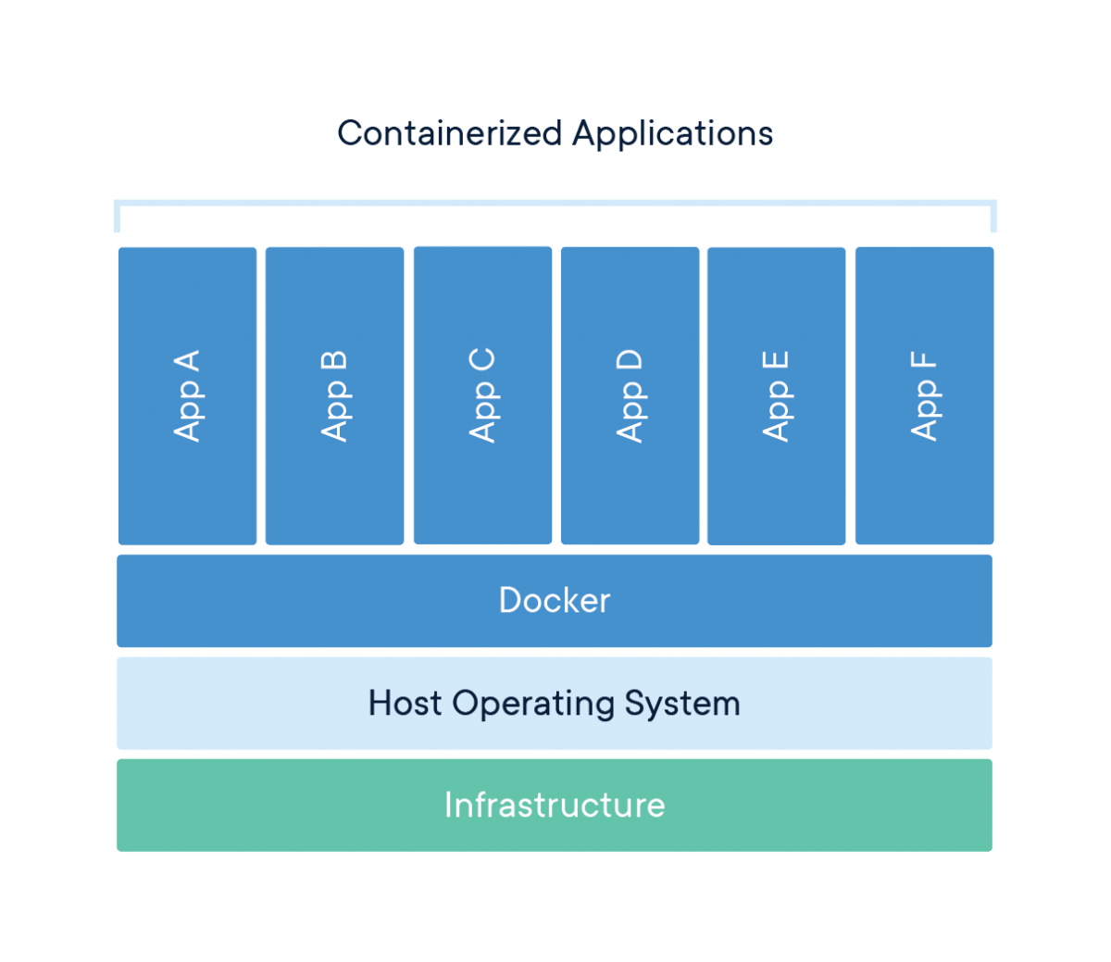
Container explanation
“A container is a standard unit of software that packages up code and all its dependencies so the application runs quickly and reliably from one computing environment to another.”
https://www.docker.com/resources/what-container/

Slide 8
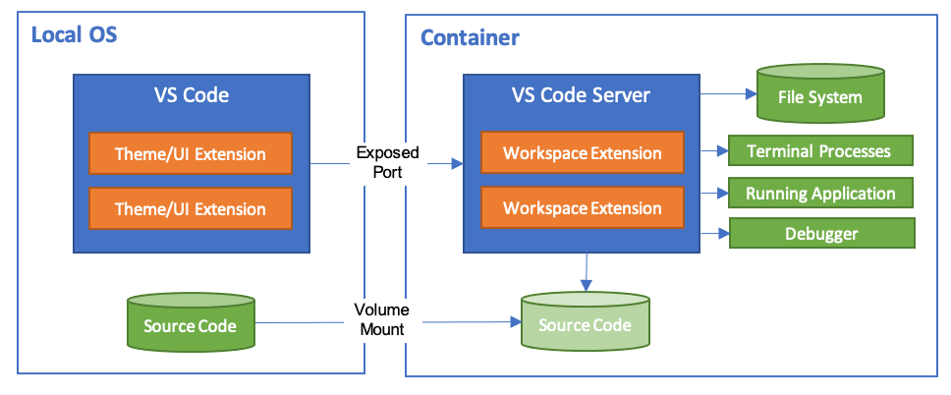
Dev container explained
https://code.visualstudio.com/docs/devcontainers/containers

Slide 9
Demo

Slide 10

THANK YOU
Feedback is a gift. Please review this session

